Slide 1
TESLA - Predictive analysis of stocks.
Bianca Daniciuc
Monica Gheorghe

Slide 2
Agenda
01
Introduction
02
Analysis
03
Curiosity: Sentiment analysis
04
Conclusion

Slide 3
Introduction
How are we going to determine this?
Why did we choose this topic?
What is the purpose of the research?

Slide 4
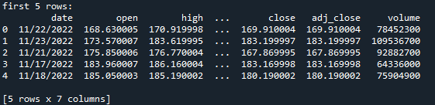

Analysis
The data we had to work with
Data source, one year data

Slide 5
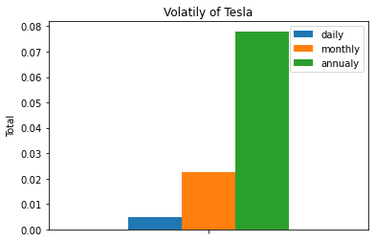
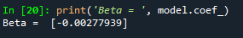
Analysis - volatility
Volatility of Tesla’s stocks – Beta value
Daily, monthly, and annually volatility

Slide 6
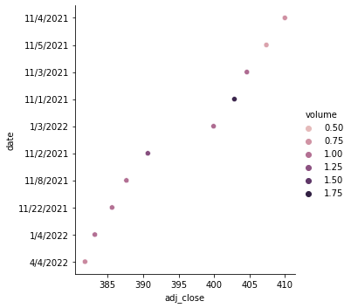
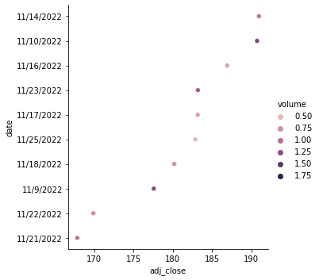
Analysis
Add Skills – 70%
Add Skills – 80%
Add Skills – 60%
First 10 days
Last 10 days
Add Skills – 90%

Slide 7
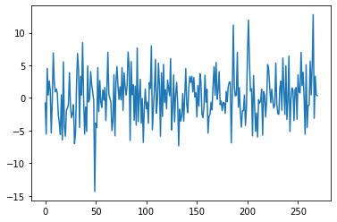
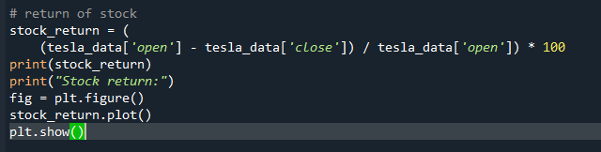
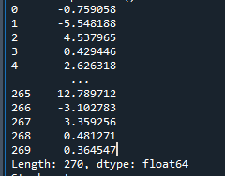
Analysis – return of stocks
Stock return
Add Skills – 70%
Add Skills – 80%
Add Skills – 60%
Add Skills – 90%

Slide 8
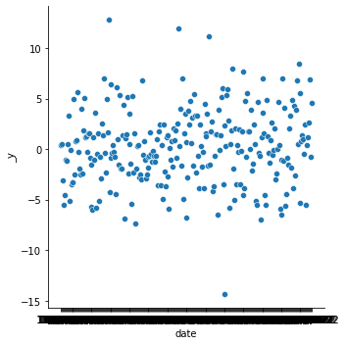
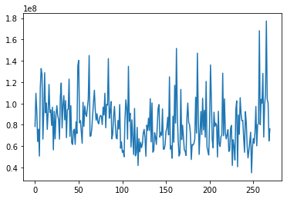
Analysis
Return of stocks per date
Volume

Slide 9
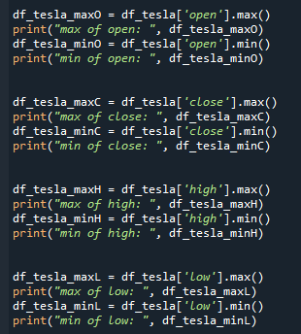
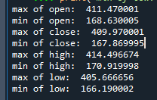
Analysis – linearity of stocks
Max and min of each open, close, high, and low.

Slide 10
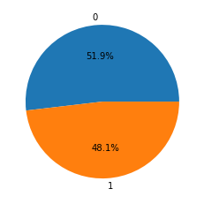
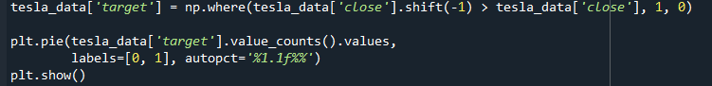
Analysis – linearity of stocks
Linear forecast, how balanced is the target for the stocks.

Slide 11
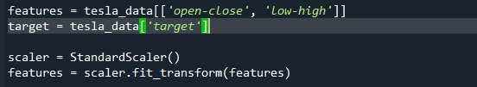
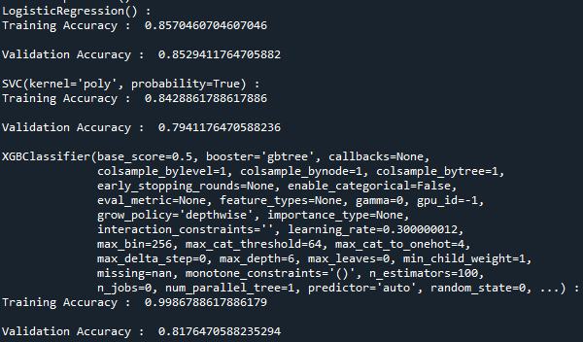
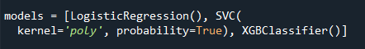
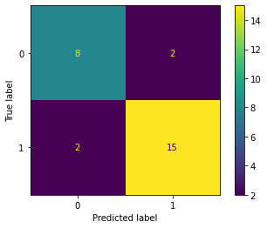
Analysis – Normalization & trainning
Result:
Normalization: StandardScaler
Trainning: Logistic Regression

Slide 12
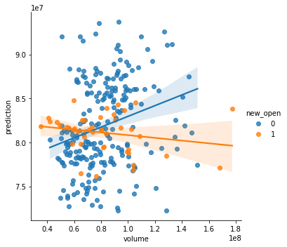
Analysis – prediction of the future price
Using LinearRegression, as it’s mostly used

Slide 13
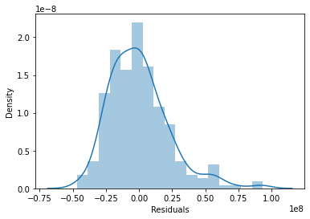
Analysis – Residuals
We found a small residual standard error as it fits the regression model

Slide 14
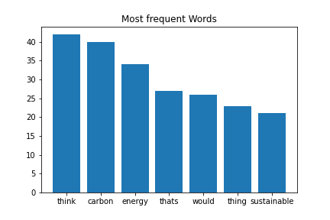
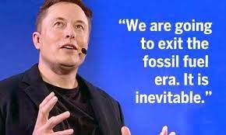
Curiosity: Sentiment analysis
Speech:
Université de Paris Panthéon Sorbonne - Sustainability

Slide 15


Curiosity: Sentiment analysis
Sentiment
Score:
0.10657329232009413

Slide 16
Conclusion
Invest or not?
Negative beta
Low volatility
Prices range from $185 to $405
CEO concerned about the future and the current situation.

Slide 17

Thank You

